Slide 1

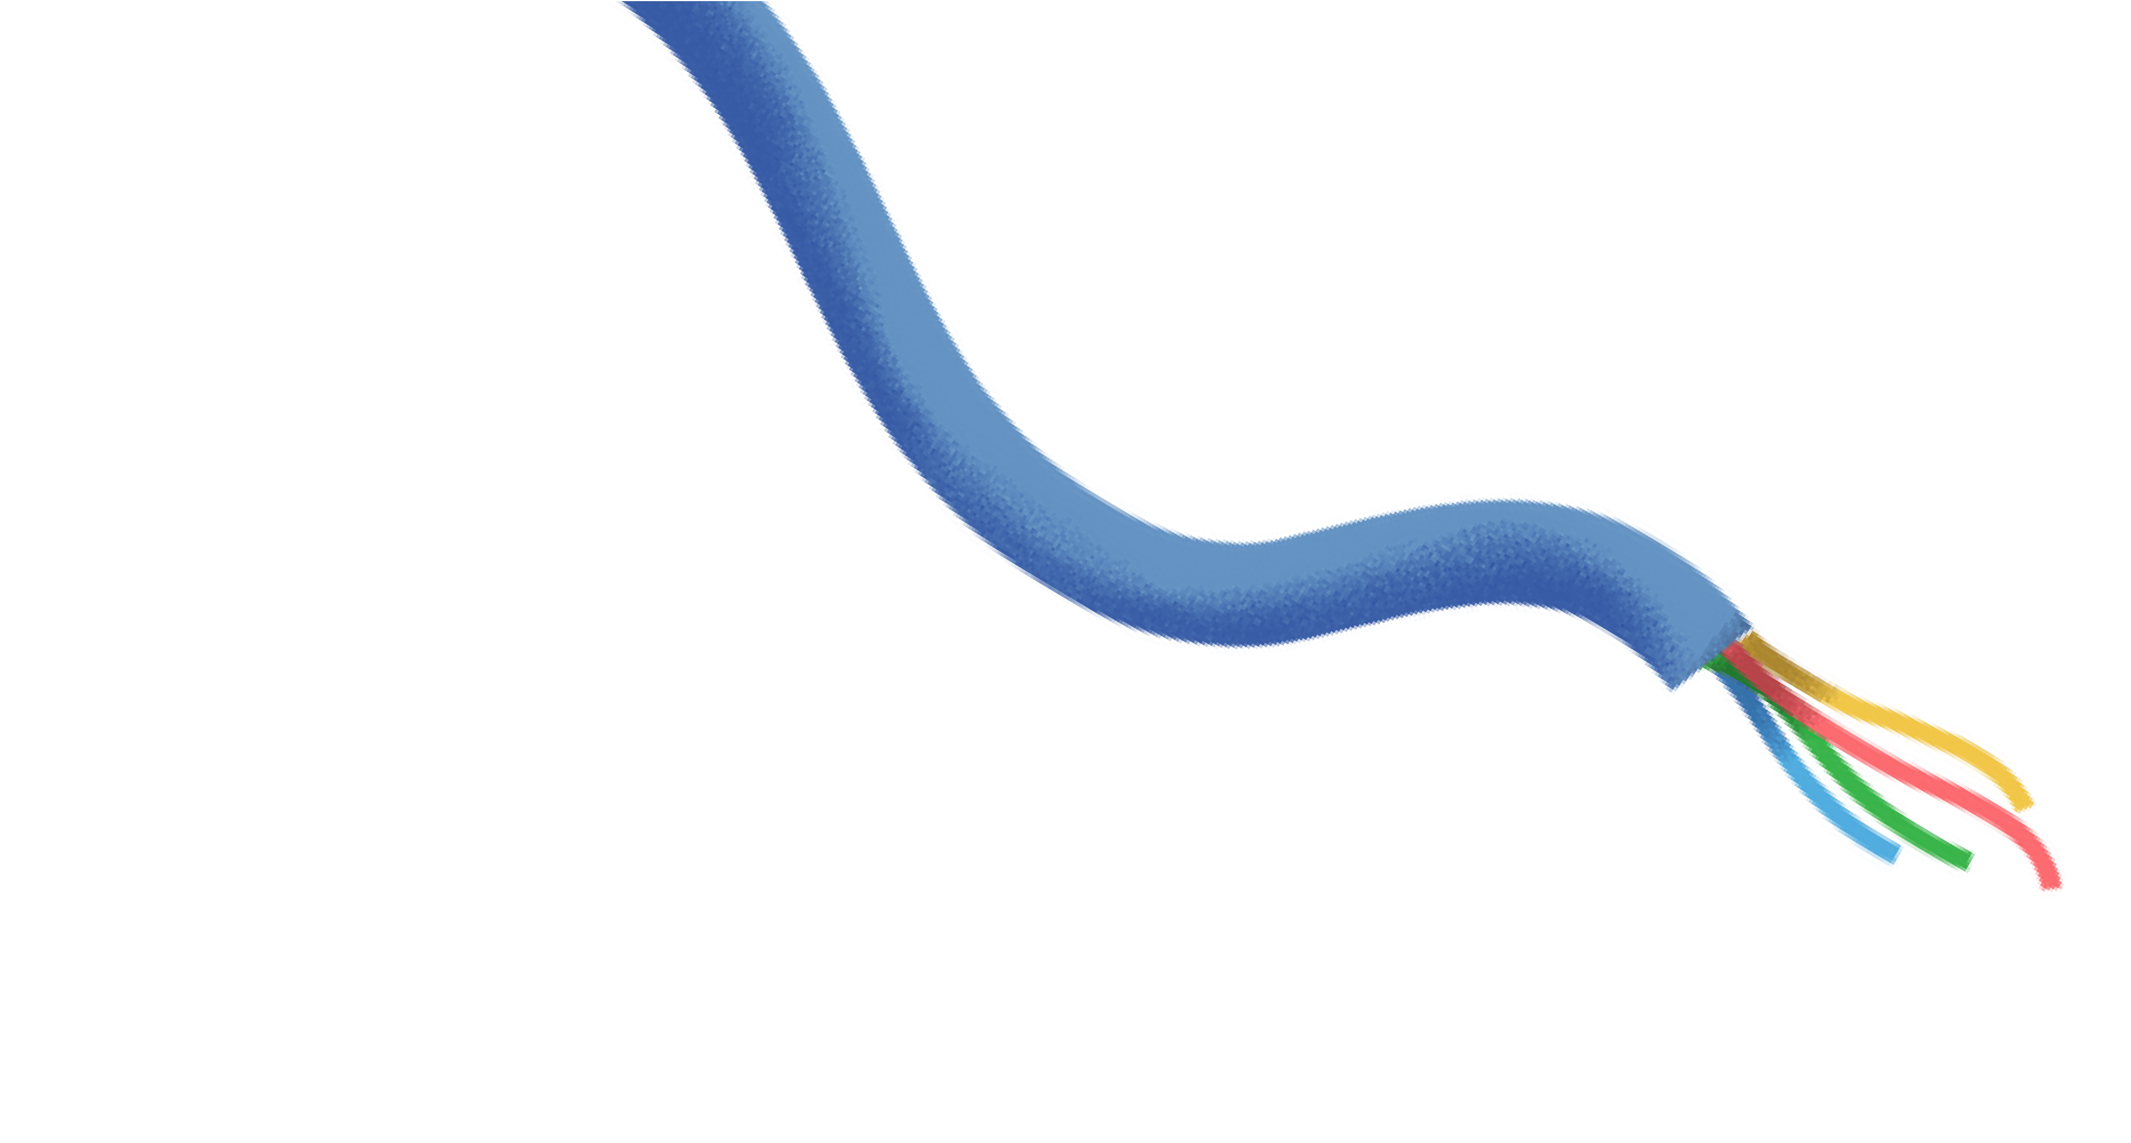




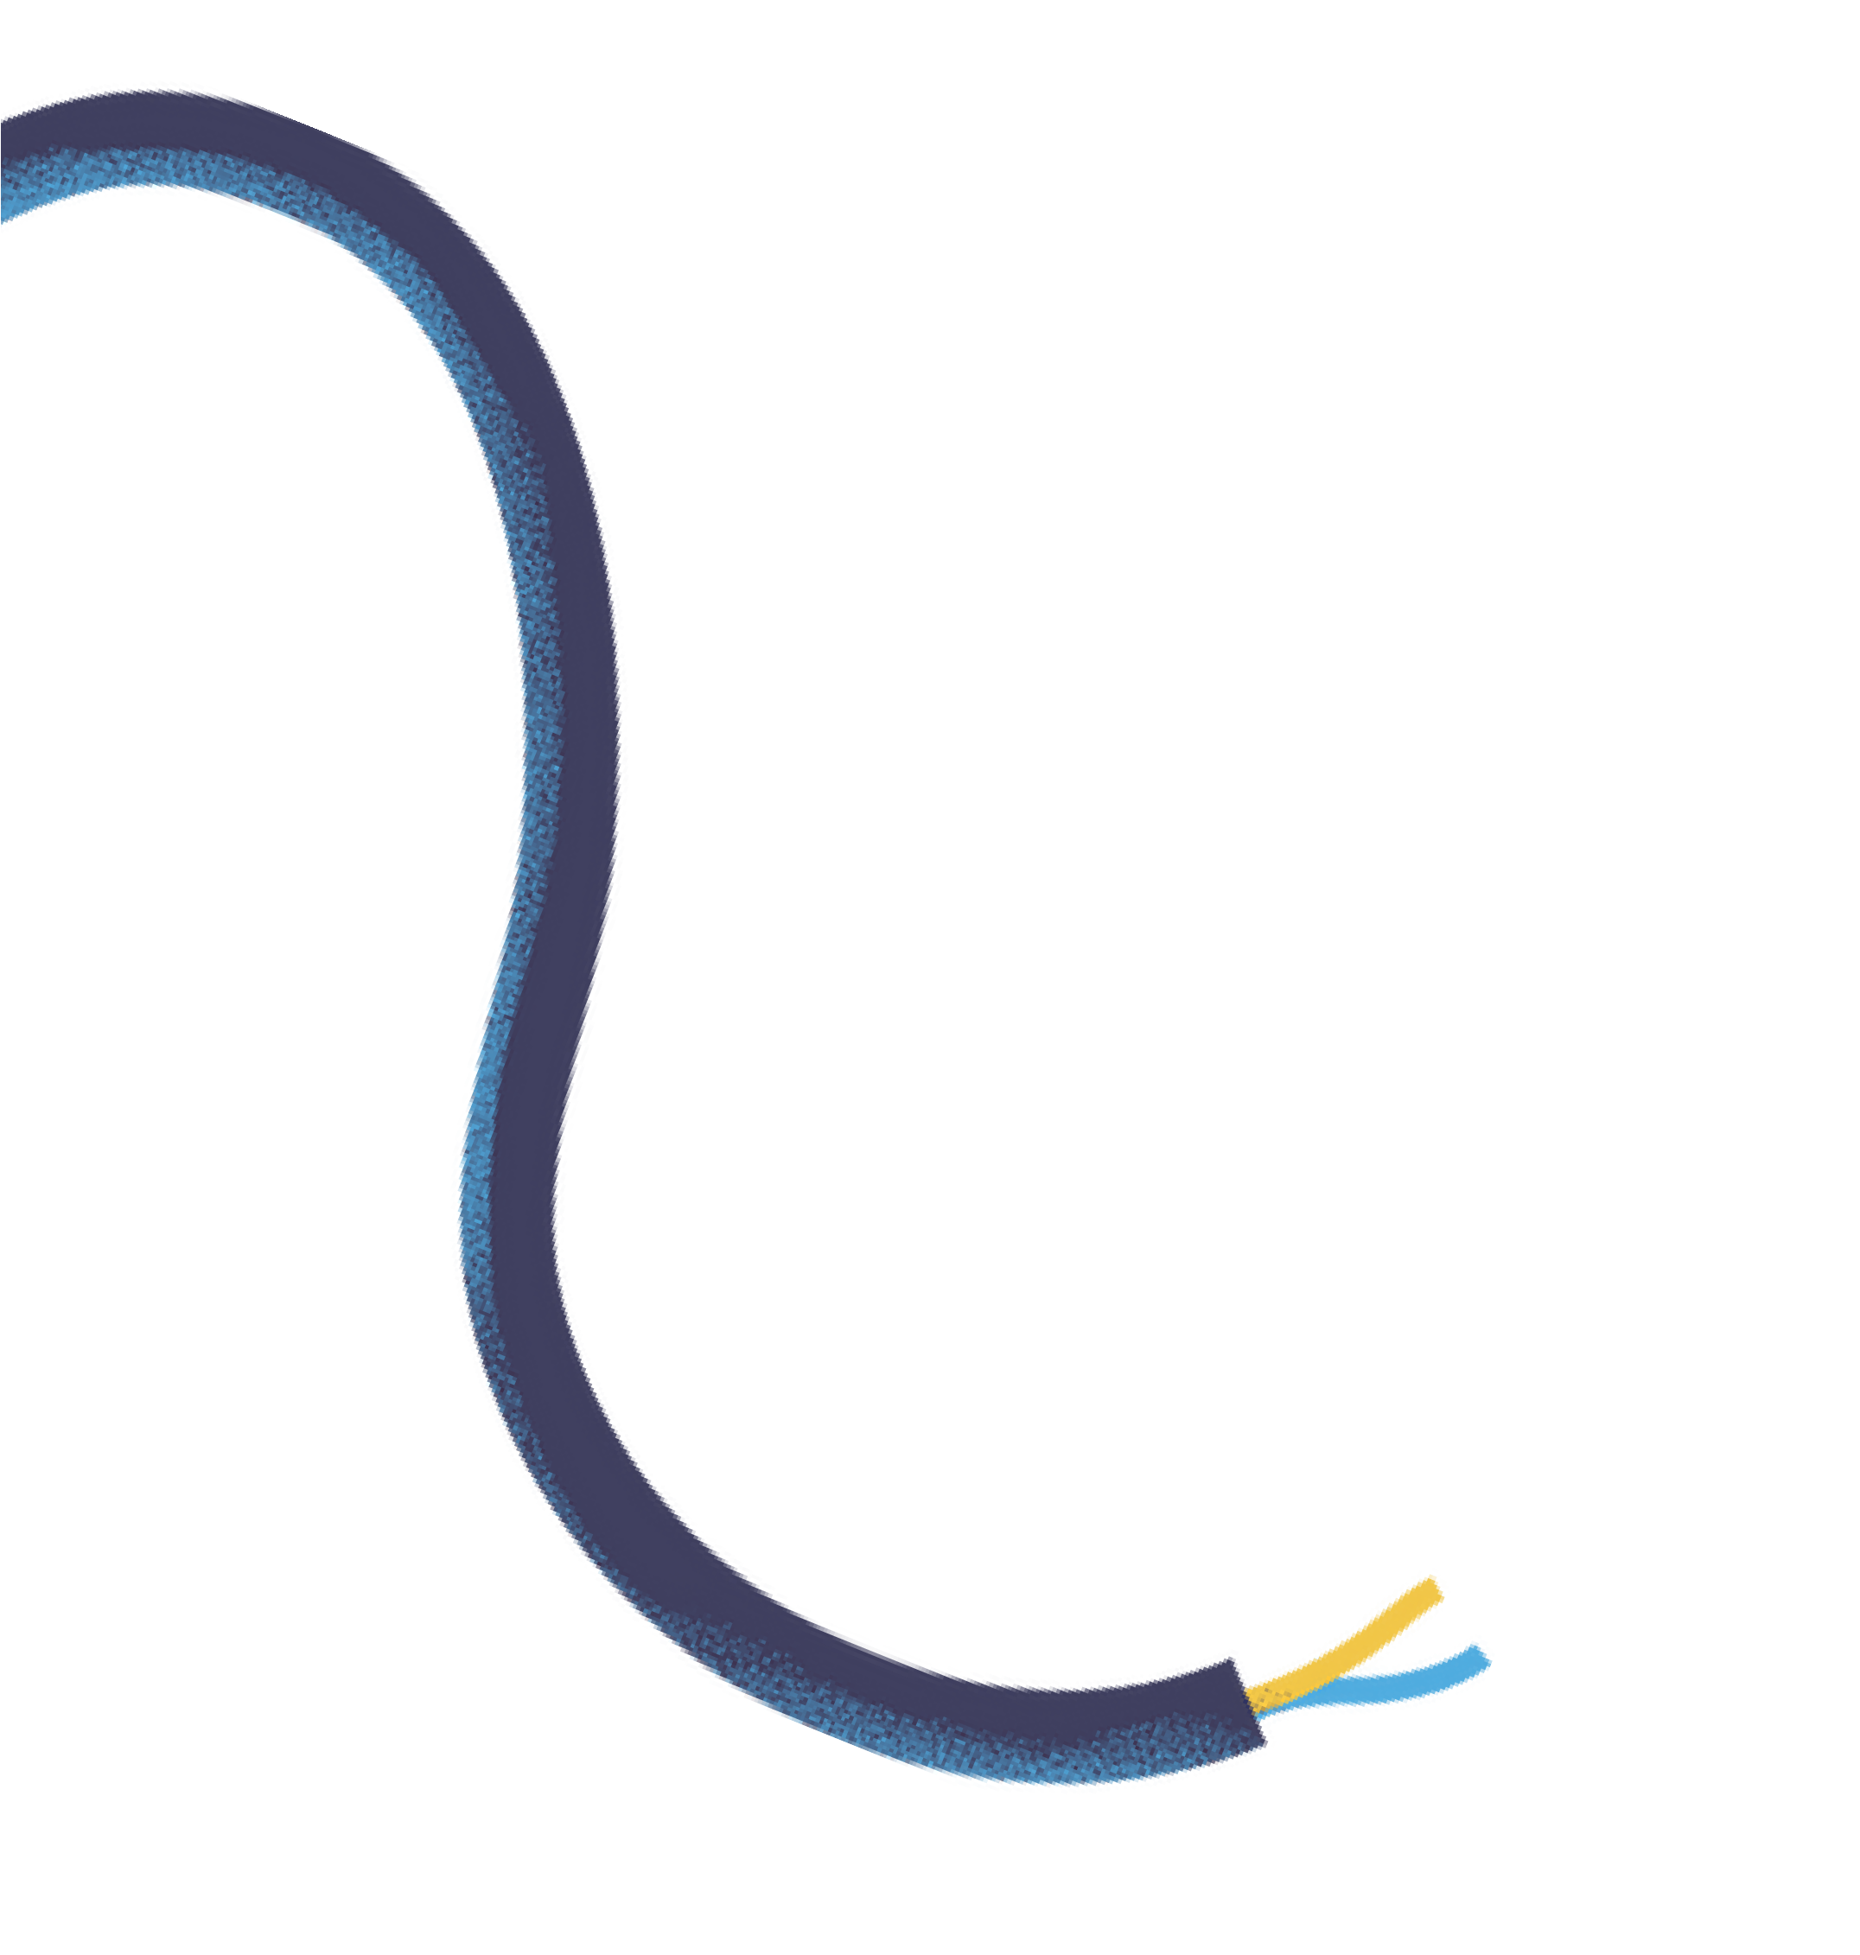


Fault Classification in Transmission Lines using Machine Learning
In Supervision of: Mr. Subho Paul

Slide 2
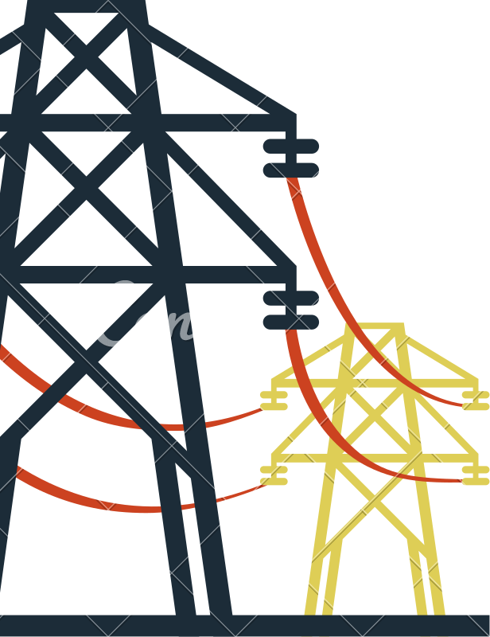






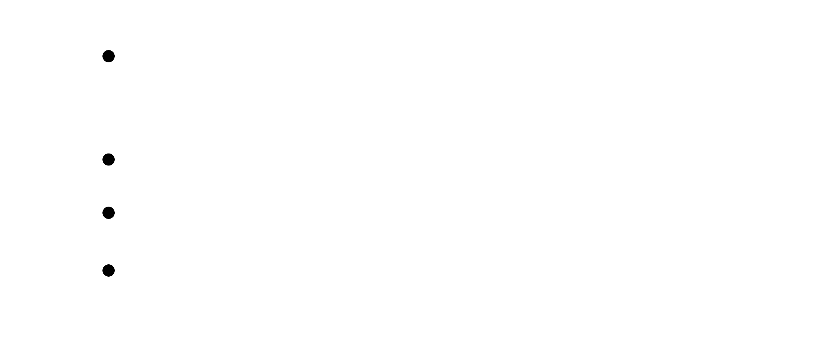








Contents
Faults in transmission lines : What, Why and How
Need for detection Proposed solution
Conclusion

Slide 3
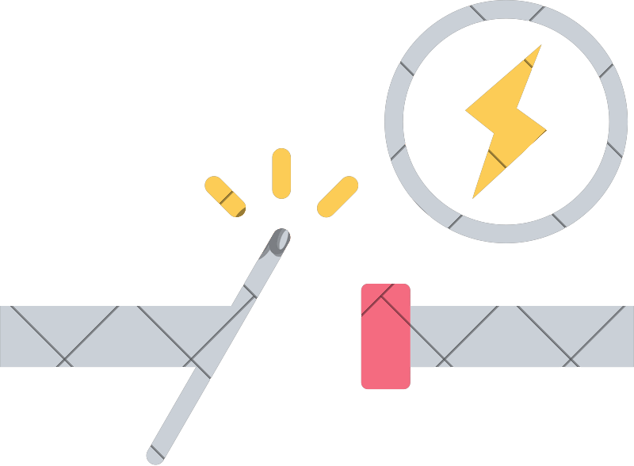




Faults in Transmission Lines: What
A fault in a transmission line refers to any abnormal condition or disruption in the normal flow of electric current.
It’s an unwanted connection between phases or to the ground, causing a sudden current surge.
Faults disturb the operation of the power system and can damage equipment if not addressed promptly.

Slide 4


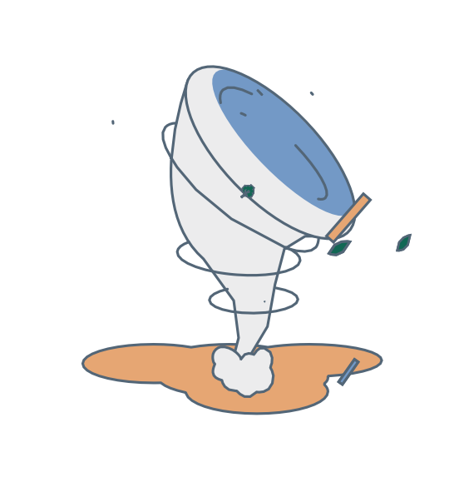

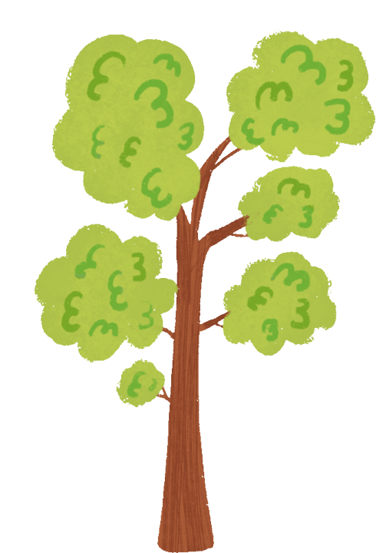
Faults in Transmission Lines: Why
1. Environmental / External Causes
Flood
Storm
Cyclone
Snowfall
Tree Falling

Slide 5

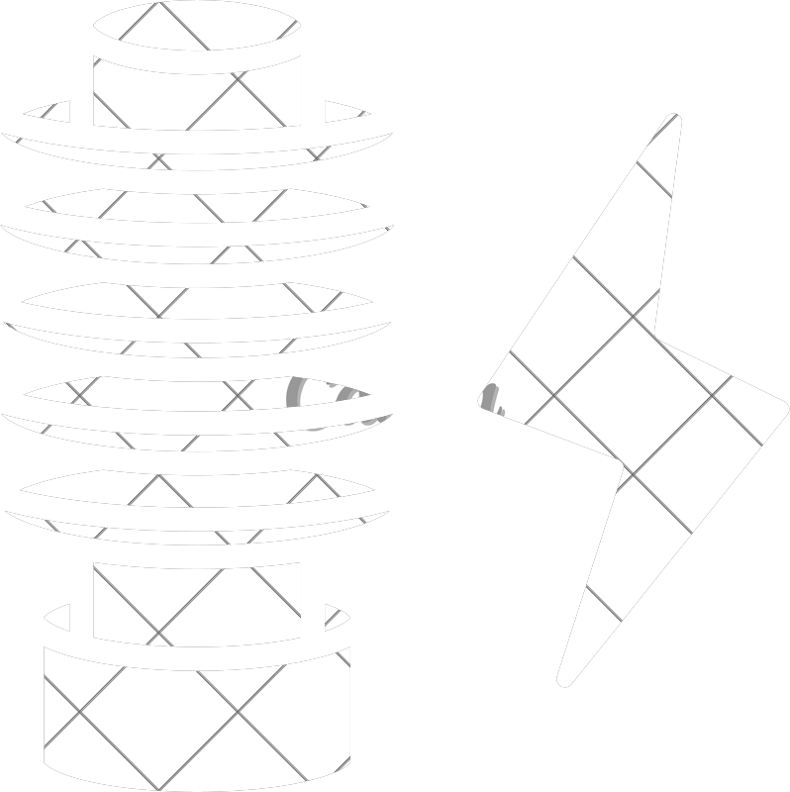

Faults in Transmission Lines: Why
2. Equipment-related / Internal Causes
Insulation Failure
Switch Gear
Poor Maintenance

Slide 6
Faults in Transmission Lines: Why
India's T&D losses have historically been high, with reports indicating losses of over 20% of generated electricity. This is more than twice the world average of 6- 8% . Such losses translate to substantial economic costs for the country.
T&D Losses 20%
As of the fiscal year 2022–23, state-owned electricity distribution companies (DISCOMs) collectively accumulated losses of around ₹6.77 lakh crore (approximately $82 billion USD). These losses have been increasing annually by an average of 10% since 2015–16
Power Theft Losses 80%
*Sources: The Economic Times, NIPFP

Slide 7
Faults and their types
FAULTS
OPEN CIRCUIT
SHORT CIRCUIT
SINGLE LINE
ASYMMETRICAL
SYMMETRICAL
DOUBLE LINE
L-L FAULT
L-L-L FAULT
TRIPLE LINE
L-G FAULT
L-L-L-G FAULT
L-L-G FAULT

Slide 8






Open Circuit Faults
Single Line - Faults
Double Line - Faults
Triple Line - Faults
Occurs when
one phase
Occurs when two phase conductors (e.g., R and Y) are open or broken, leaving only one phase connected.
Occurs when all three phase conductors (R, Y, B) are disconnected.
conductor (e.g., R) is broken or disconnected, while the other two remain intact.

Slide 9
Short Circuit Faults
SYMMETRICAL
ASSYMETRICAL
*Our focus for classification is on these faults.

Slide 10
Symmetrical Faults
Line to Line to Line (LLL) - Faults
LLL faults, or three-phase faults, occur when all three phases (R, Y, B) are short-circuited together without involving the ground.
Line to Line to Line to Ground (LLLG) - Faults
LLL-G faults, or three-phase-to-ground faults, occur when all three phases (R, Y, B) are short-circuited together and also connected to the ground.

Slide 11
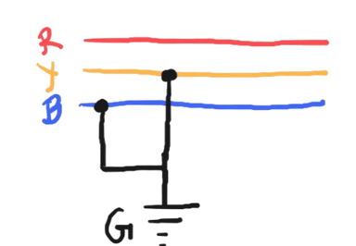
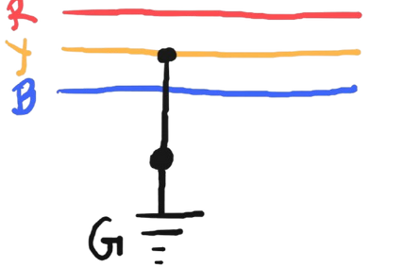
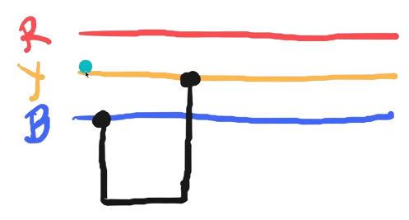
Asymmetrical Faults
Line to Ground (LG) - Faults
Line to Line (LL) - Faults
Line-to-Line (LL) faults occur when two phase conductors
Line to Line to Ground (LLG) - Faults
Line-to-Line-to-Ground (LLG) faults occur when two phase
(LG) faults occur when one phase
Line-to-Ground
conductor (R, Y, or B) comes into direct contact with the ground or a grounded object.
(e.g., R and Y) come into contact with each other
conductors (e.g., R and Y) come into contact with each other and with the ground.
without involving the ground.

Slide 12
Faults in Transmission Lines: How
I. Fault Detection Techniques
Threshold-based Methods
Signal Processing Techniques
II. Fault Classification Techniques
Machine Learning Techniques
Signal Processing Techniques

Slide 13
Proposed Work
Data-driven Method
We use historical data and machine learning (ML) for fault detection without a physical model
1. Random Forest Algorithm
2. Support Vector Machine
3. Decision Tree Algorithm
4. XGBoost
5. KNN Algorithm

Slide 14
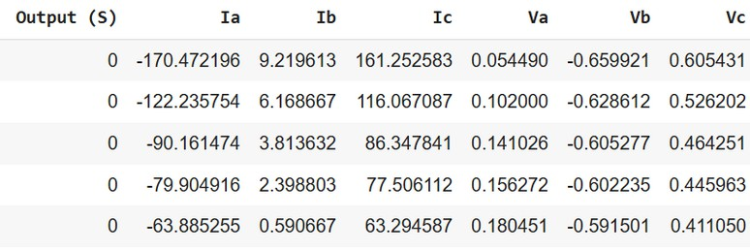
Datasets Used:
1. The “Detect.csv” dataset contains the line voltages and current values for fault detection: Either Yes or No!
Fault 45.8%
No Fault 54.2%
Detect.csv
Figure 2

Slide 15

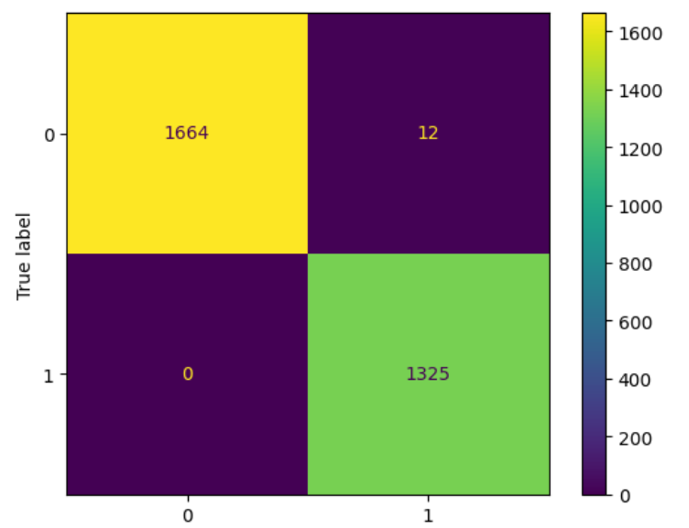

SVM Classifier Report
This is a binary classification problem. The algorithm creates a decision boundary between fault an no-fault conditions
The graph depicts the training accuracy and testing accuracy.
Training Acc.: 99.78%
Testing Acc.: 99.60%
The confusion matrix represents the actual (true) values of fault and no- fault along with their corresponding predictions.

Slide 16
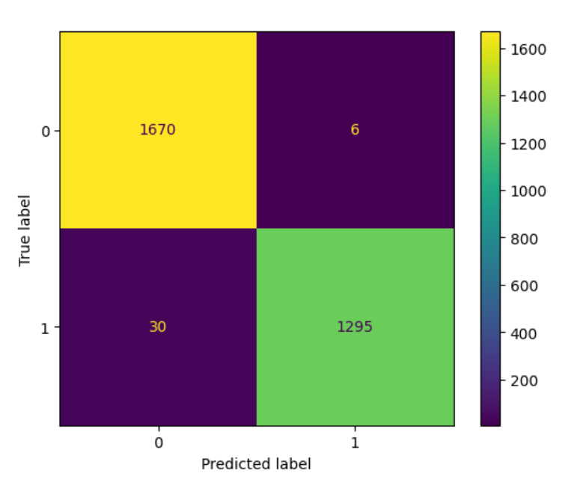

Decision Tree Classifier Report
This is a binary classification problem. The algorithm creates decision trees for nodes fault and no-fault.
The graph depicts the training accuracy and testing accuracy.
Training Acc.: 99.91%
Testing Acc.: 98.88%
The confusion matrix represents the actual (true) values of fault and no- fault along with their corresponding predictions.

Slide 17
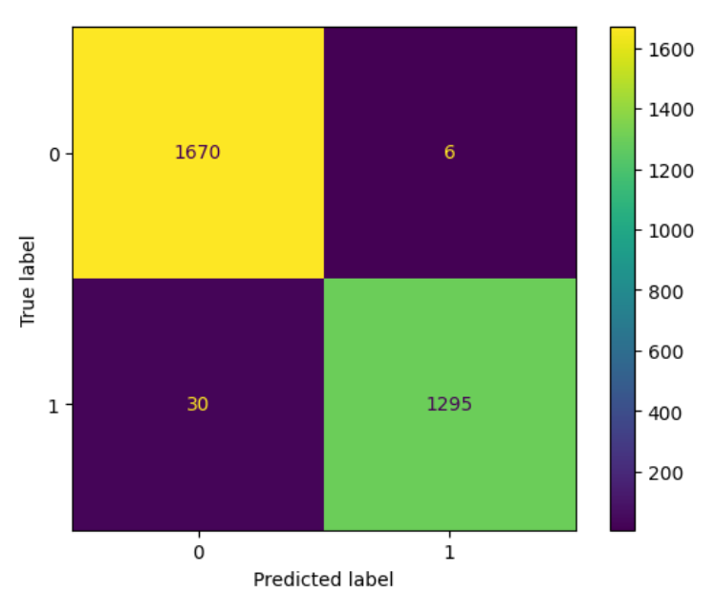
KNN Classifier Report
This is a binary classification problem.The algorithm chooses optimal value for k and predicts whether the test point is fauly or not.
The graph depicts the training accuracy and testing accuracy.
Training Acc.: 99.83%
Testing Acc.: 99.53%
The confusion matrix represents the actual (true) values of fault and no- fault along with their corresponding predictions.

Slide 18
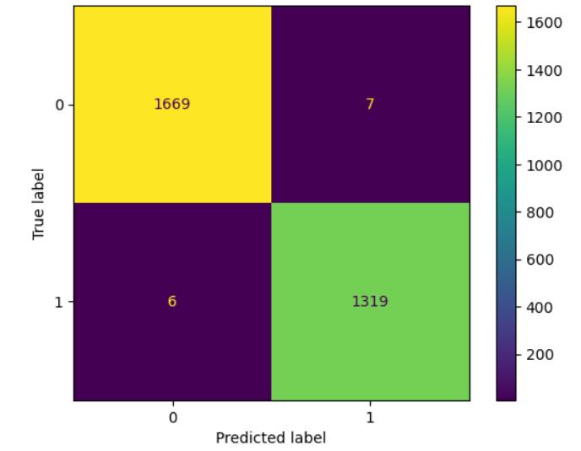
XGBoost Classifier Report
This is a binary classification problem. Trees are added one by one, and each new tree's predictions are added to the previous output.
The graph depicts the training accuracy and testing accuracy.
Training Acc.: 99.93%
Testing Acc.: 99.56%
The confusion matrix represents the actual (true) values of fault and no- fault along with their corresponding predictions.

Slide 19
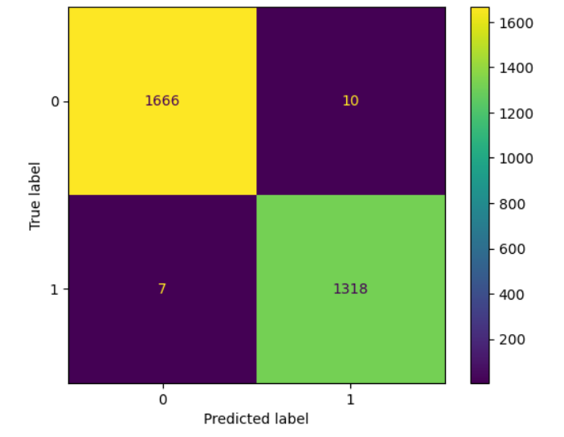
Random Forest Classifier Report
This is a binary classification problem.
Random Forest creates a large number of decision trees during training. Each tree learns to make predictions (e.g., fault vs no-fault).
The graph depicts the training accuracy and testing accuracy.
Training Acc.: 99.98%
Testing Acc.: 99.43%
The confusion matrix represents the actual (true) values of fault and no- fault along with their corresponding predictions.

Slide 20
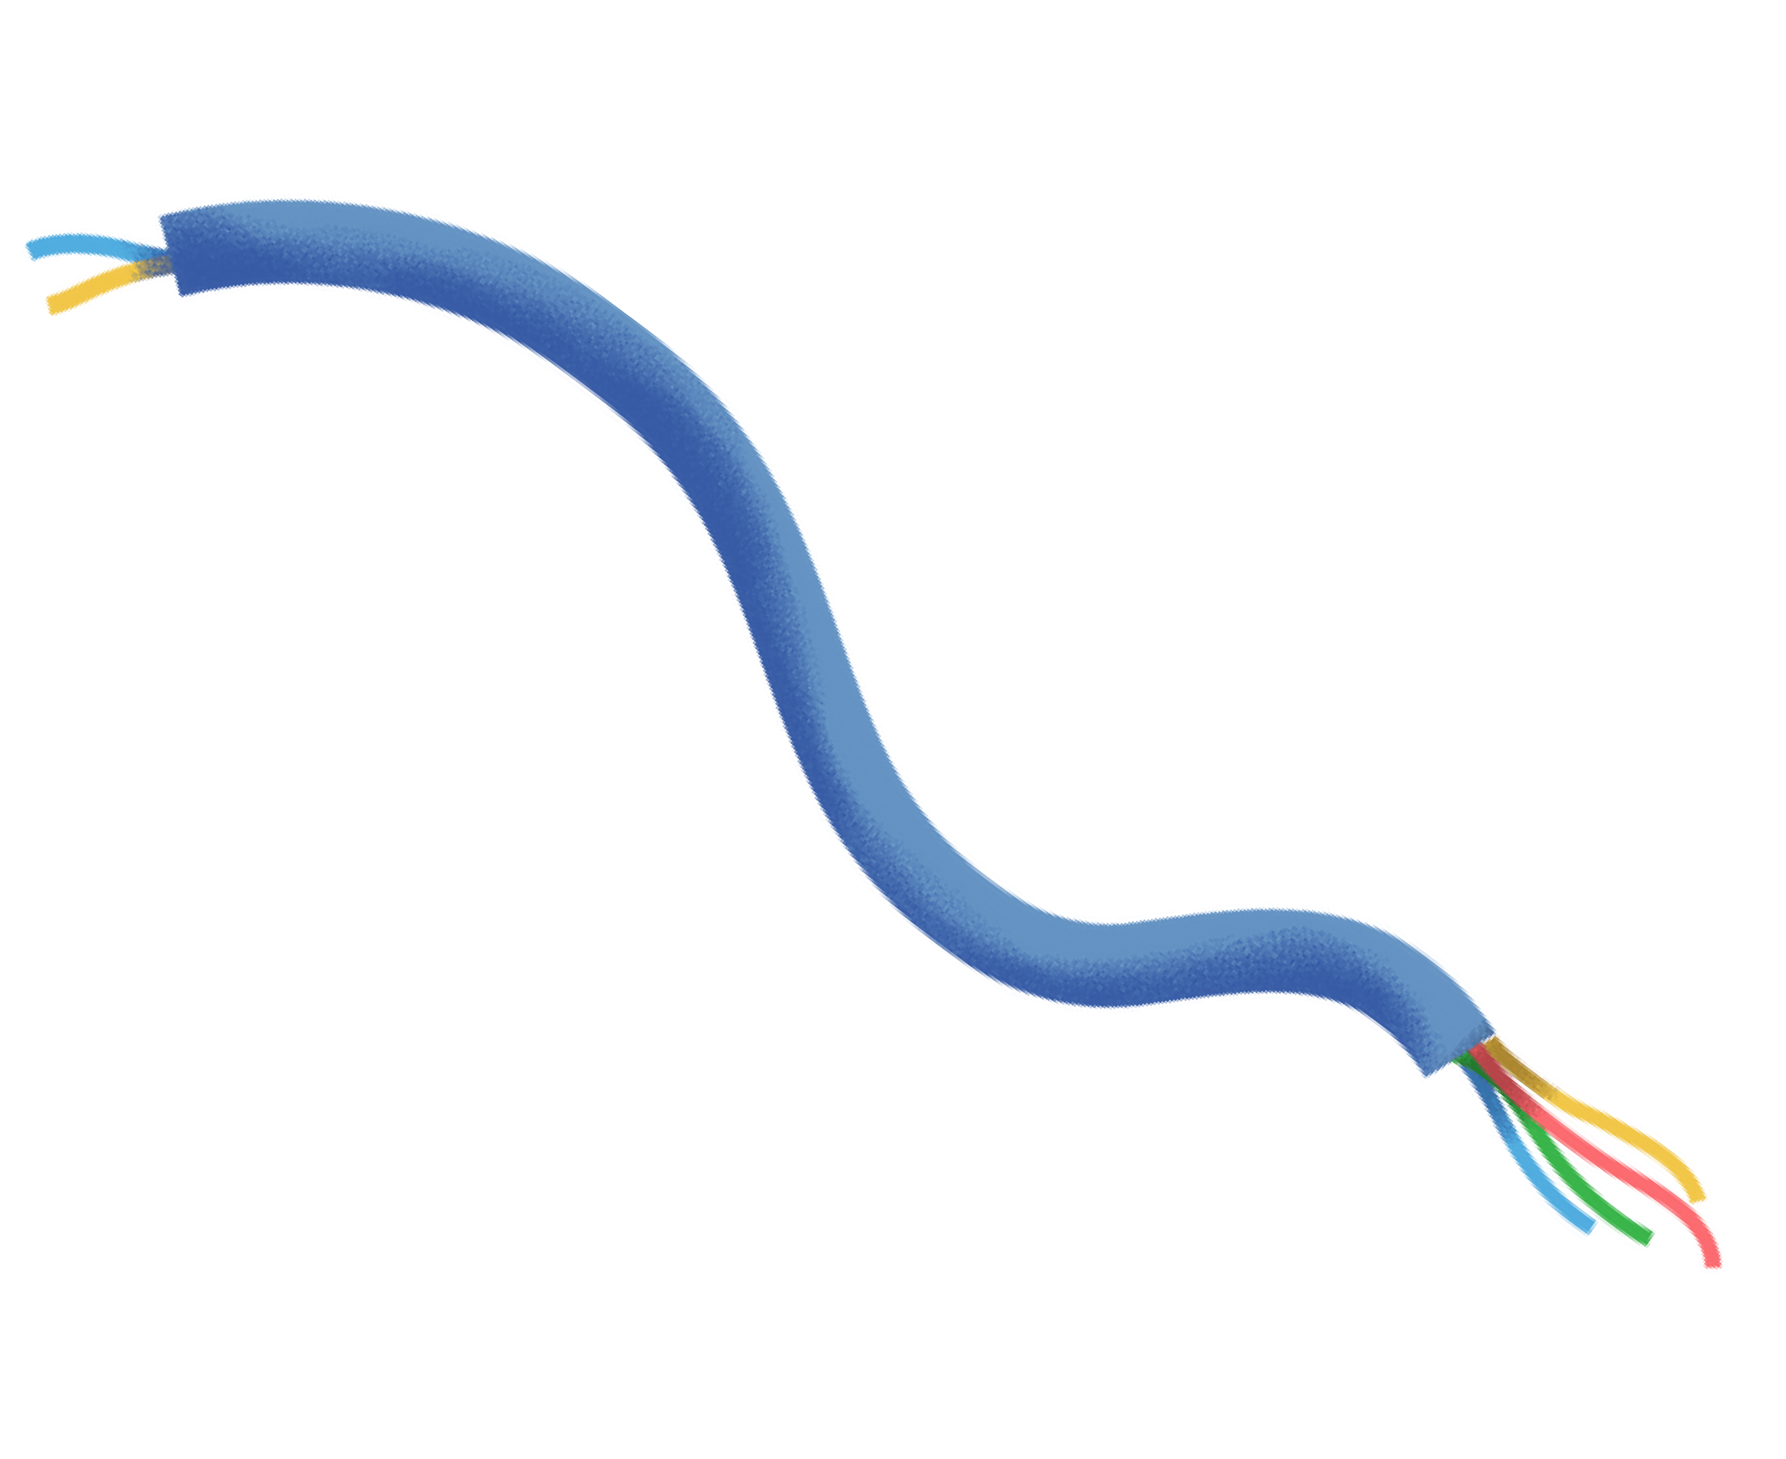



Comparing the Models:
The best training accuracy is offered by Random Forest Algorithm of 99.98%.
The best testing accuracy is offered by SVM Classifier of 99.60%.
The SVM Classifier is thus used as the Emperical Risk is minimum for this algorithm.

Slide 21
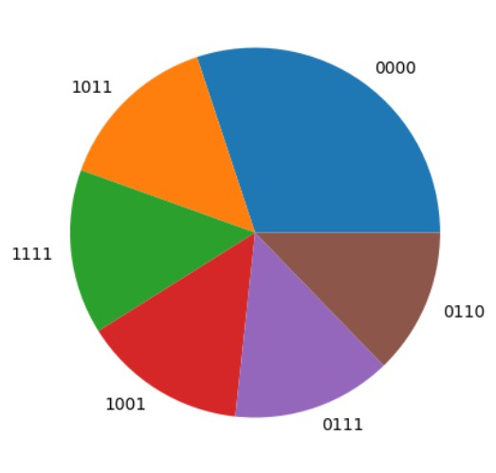
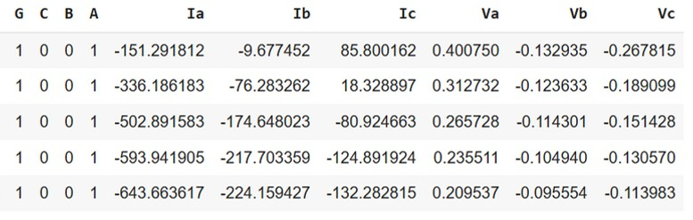
Datasets Used:
2. The “ClassData.csv” dataset contains the line voltage and current values for different fault conditions as depicted in
figure 1.
Figure 1
ClassData.csv

Slide 22
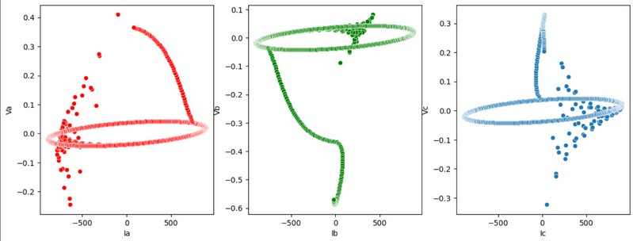
Class.csv: Relation between line voltages and currents.
1. For LLLG Fault

Slide 23
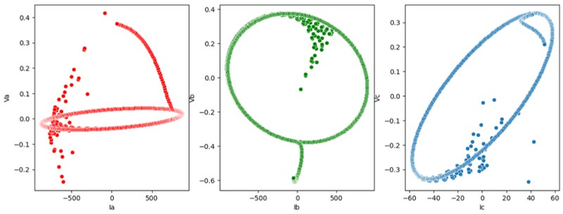
Class.csv: Relation between line voltages and currents.
2. For LLG Fault

Slide 24
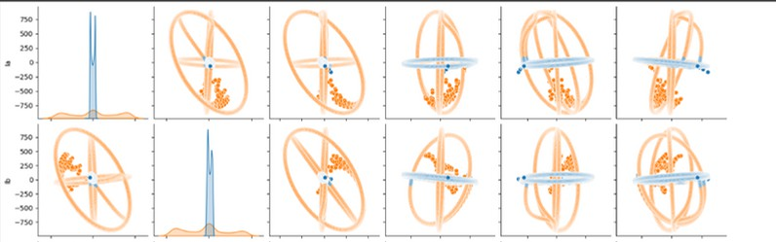
Class.csv: Relation between line voltages and currents.
Current Variations with the Line Currents and Voltages

Slide 25
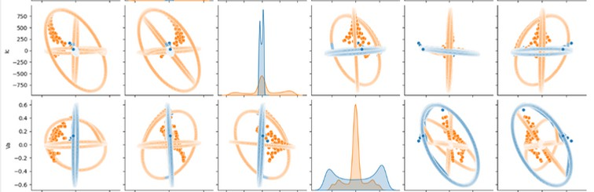
Class.csv: Relation between line voltages and currents.
Current Variations with the Line Currents and Voltages

Slide 26
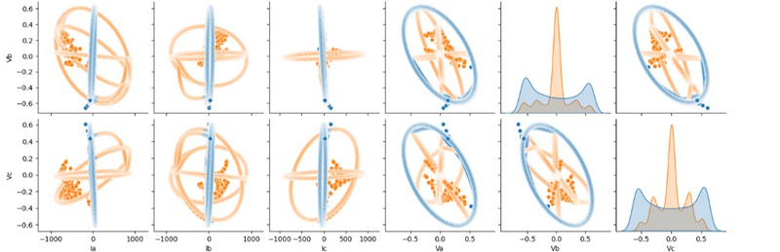
Class.csv: Relation between line voltages and currents.
Current Variations with the Line Currents and Voltages

Slide 27
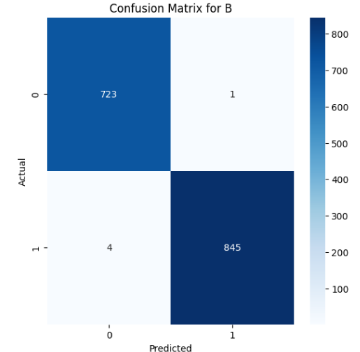
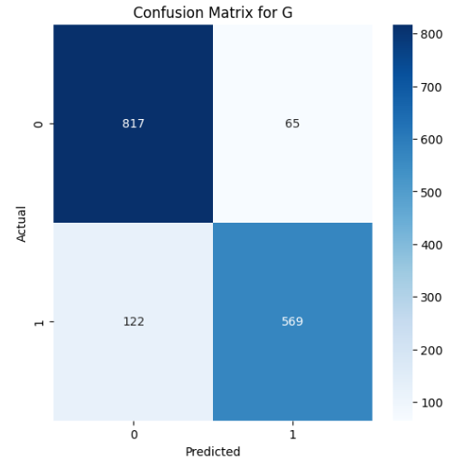

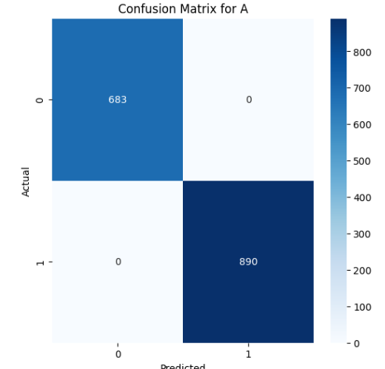
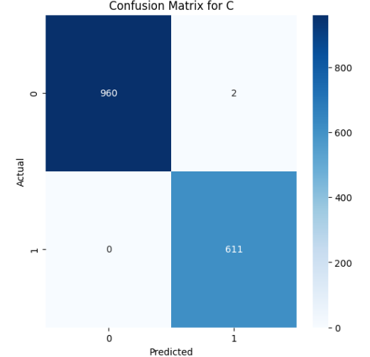
SVM Classifier Report
This is a multiclass classification problem. The algorithm creates a decision boundary between fault an no-fault conditions
The graph depicts the training accuracy and testing accuracy.
Testing Acc.: 87.73%
The confusion matrix represents the actual (true) values of fault and no- fault along with their corresponding predictions.

Slide 28
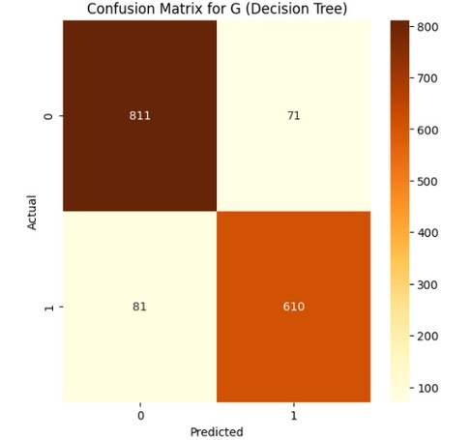
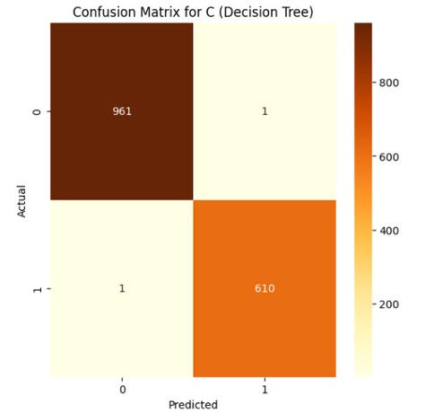

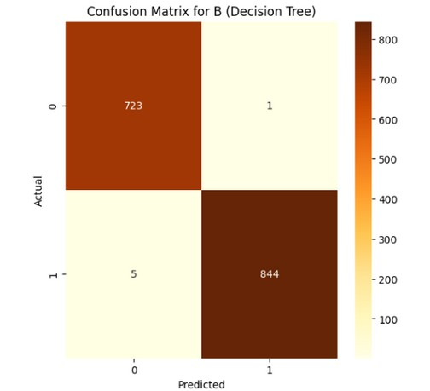
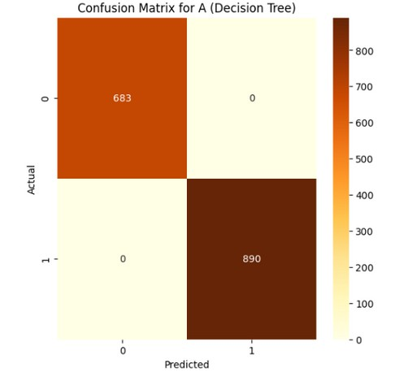
Decision Tree Classifier
This is a multilabel classification problem. The algorithm creates decision trees for nodes fault and no-fault.
The graph depicts the training accuracy and testing accuracy.
Testing Acc.: 89.95%
The confusion matrix represents the actual (true) values of fault and no- fault along with their corresponding predictions.

Slide 29
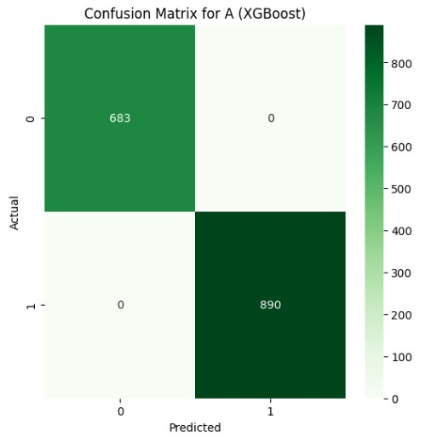
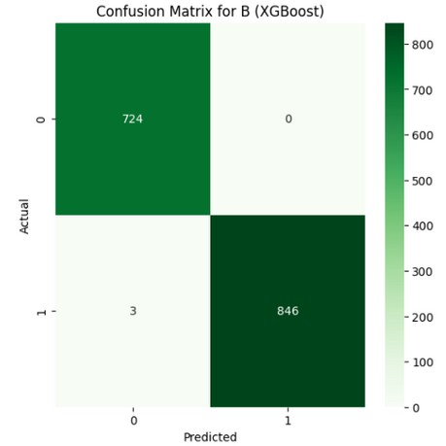

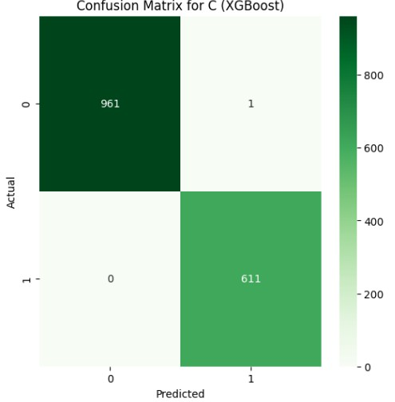
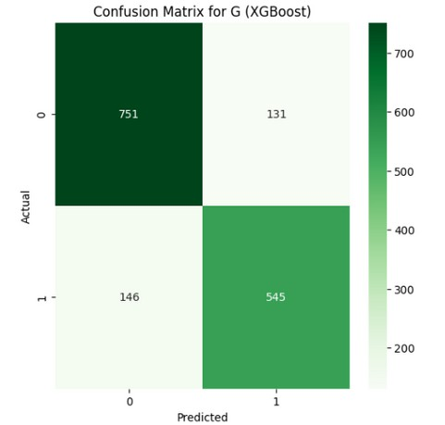
XGBoost Classifier
This is a multiclass classification problem. Trees are added one by one, and each new tree's predictions are added to the previous output.
The graph depicts the training accuracy and testing accuracy.
Testing Acc.: 82.10%
The confusion matrix represents the actual (true) values of fault and no- fault along with their corresponding predictions.

Slide 30
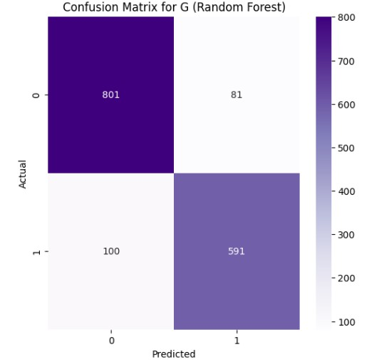
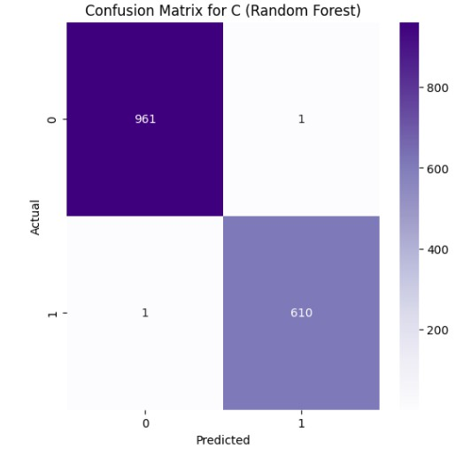
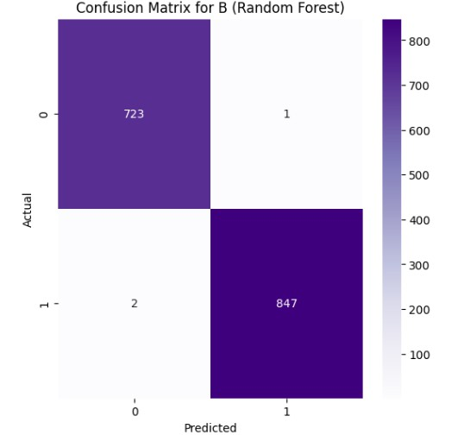
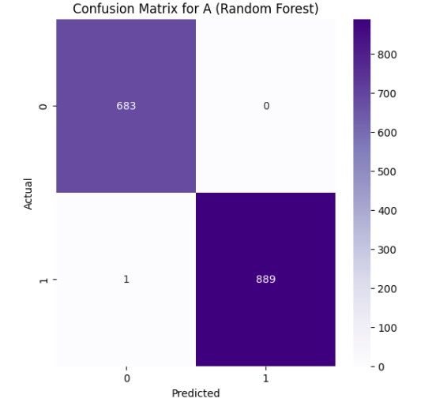
Random Forest Classifier
This is a multiclass classification problem. Random Forest creates a large number of decision trees during training. Each tree learns to make predictions (e.g., fault vs no-fault)
The graph depicts the training accuracy and testing accuracy.
Testing Acc.: 88.36%
The confusion matrix represents the actual (true) values of fault and no- fault along with their corresponding predictions.

Slide 31
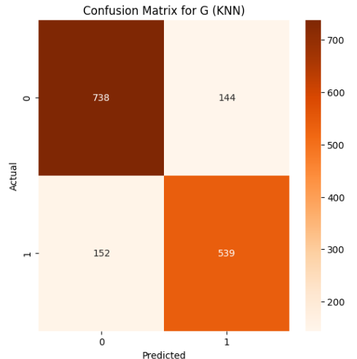


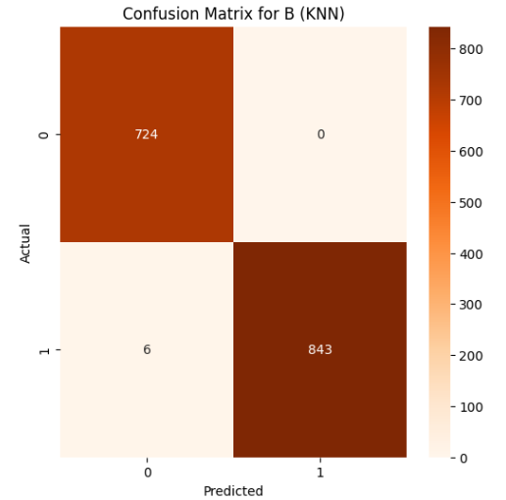
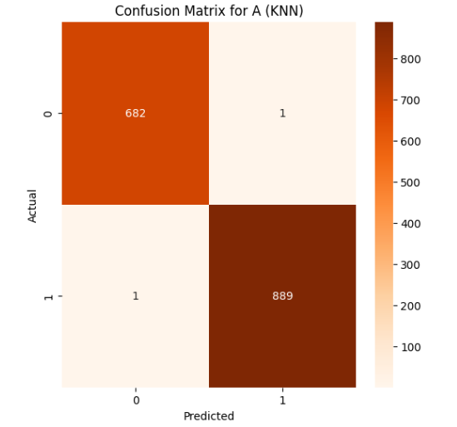
KNN Classifier
This is a multiclass classification problem. The algorithm chooses optimal value for k and predicts whether the test point is fauly or not.
The graph depicts the training accuracy and testing accuracy.
Testing Acc.: 80.54%
The confusion matrix represents the actual (true) values of fault and no- fault along with their corresponding predictions.

Slide 32
Comparing the Models:
The best testing accuracy has been offered by Decision Tree Classifier of 89.95% followed by Support Vector Machine with accuracy 87.73%
The SVM Classifier is thus used as the Empirical Risk is minimum for this algorithm.

Slide 33

Conclusion
In this exploratory project, we learned about different types of faults that occur in transmission lines and created different ML models to classify them.
The algorithms proposed suggested us to use SVM’s for fault detection and Decision Trees for fault classification.
The results demonstrate the effectiveness of ML in improving fault diagnosis and support its application in real-time power system monitoring.

